Slide 1
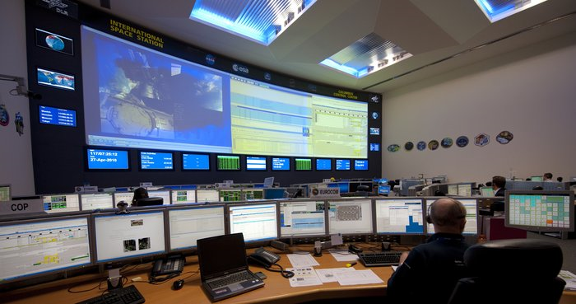
CONTROL of HUMAN BODY
Brain & Glands work together to maintain us.
Brain uses senses to receive information. It then sends messages to muscles to respond to what is happening. It also controls our glands.
Glands of the Endocrine System (to be studied in our next section) send chemical messengers - called hormones - in the blood to get specific changes happening in specific parts of body.

Slide 2
HUMAN RESPONSE to the ENVIRONMENT
NERVOUS SYSTEM linked to BRAIN
SENSE ORGANS of EYE, EAR, SKIN
ENDOCRINE GLANDS

Slide 3
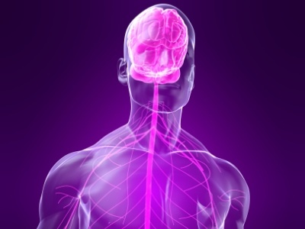
The NERVOUS SYSTEM
This involves cells linked with the brain. These cells are called NEURONS. There are three types:
1. Sensory neuron – bring messages from senses to brain.
2. Motor neuron – bring messages from brain to muscles and organs.
3. Connecting Inter-neuron – links a sensory neuron to a motor neuron in an emergency. (See section on Reflex Action.)

Slide 4
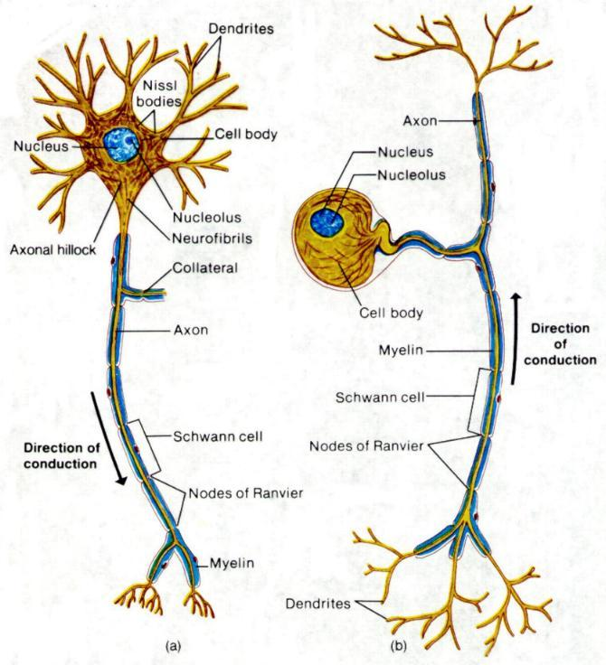

Slide 5
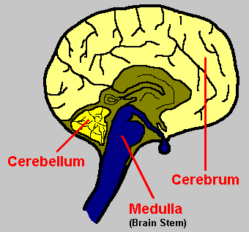
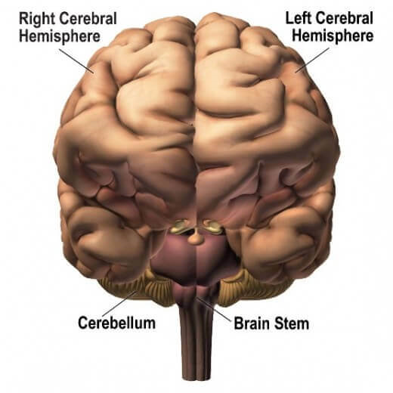
STRUCTURE of HUMAN BRAIN

Slide 6
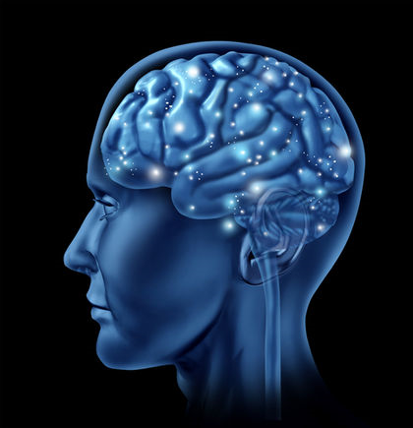
CENTRAL NERVOUS SYSTEM
Involves the BRAIN and the SPINAL CORD.
BRAIN: Protected by the Skull
Cerebrum: Thinking, Senses, Muscle Control.
Cerebellum: Co-Ordination, Posture, Balance.
Medulla Oblongata: Involuntary Control.
Neurons are arranged so that nuclei are clumped in the same area (looks grey) while the axon section (white) is together.
The Brain has grey matter on the outside, white matter on the inside.

Slide 7
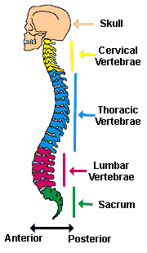
SPINAL CORD
Protected by Vertebral Bones, Meninges Membranes, Cerebro-Spinal Fluid.
Has grey Matter on the inside, White Matter on the outside.
It is an extension of the Brain, and is the base for involuntary reflex actions – studied soon.
Body sends messages through it to the brain.
Brain sends messages through it to the body.

Slide 8
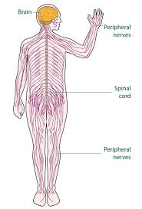
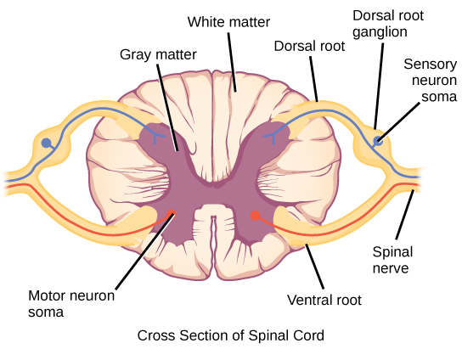
STRUCTURE of SPINAL CORD

Slide 9
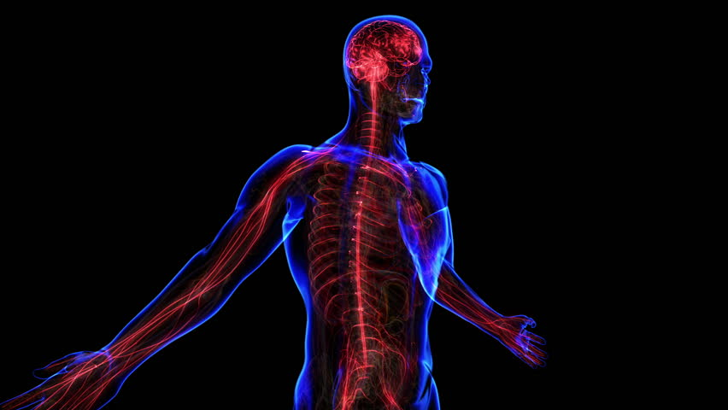
PERIPHERAL NERVOUS SYSTEM
These are all the autonomic neurons (in both directions) that connect the Central Nervous System with the rest of the body. This is how senses send messages to the brain, and how the brain gets messages to the muscles and organs.
These neurons branch off from vertebral column to connect with all the different parts of the body.
Sympathetic systems stimulate (speed up) action.
ParaSympathetic systems slow down actions.

Slide 10
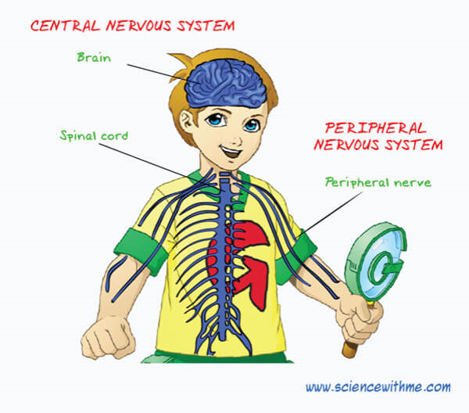
SIMPLY PERIPHERALS

